Slide 1
Bechdel Test
December 4, 2019

Slide 2
Background
We are interested in seeing how the representation of women in film has changed before, during and after the #MeToo movement beginning in 2016.

Slide 3
Research Questions
Has Hollywood shifted its behaviors in the creation of female movies after #MeToo?
The Bechdel Test
Are more movies passing the test?
Is there a demand for movies with female representation?
Gross Earnings
How do the earnings of films that pass the test compare to those that failed?
Is Hollywood putting money into films that passed the test?
Budget
How do budgets for films that pass the test compare to those that failed?
How are audiences responding to movies that pass the test?
Return Value
How does the return value for movies that pass the test compare to movies that failed?

Slide 4
Variables
We added a variable for return rate by subtracting budget from gross
We removed variables with missing data in the budget, gross, and return analysis
Only removed variables that had entirely NA’s
We added a column to adjust for inflation in 2019

Slide 5
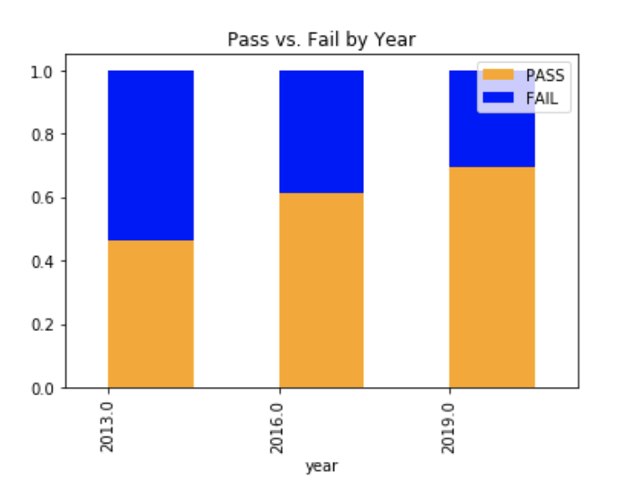
Trend analysis
Findings
In 2013, there was about an equal amount of movies that passed and failed. In the Dollars-And-Cents case, Hickey notes than the proportion of movies that passed had “flatlined” from 2000-2013. After 2013, we see the proportion of pass to fail begin to grow. The amount of movies that pass now exceeds the amount of movies that fail the test.

Slide 6
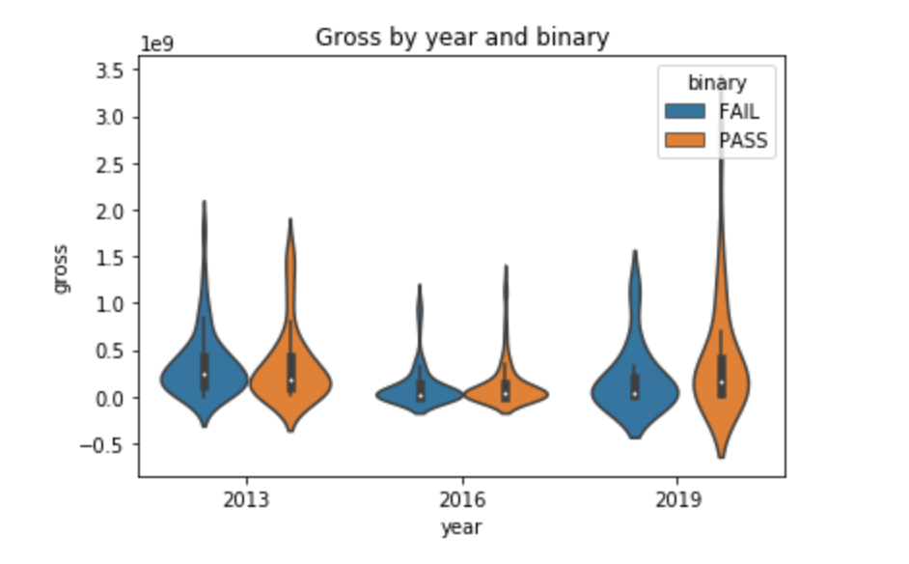
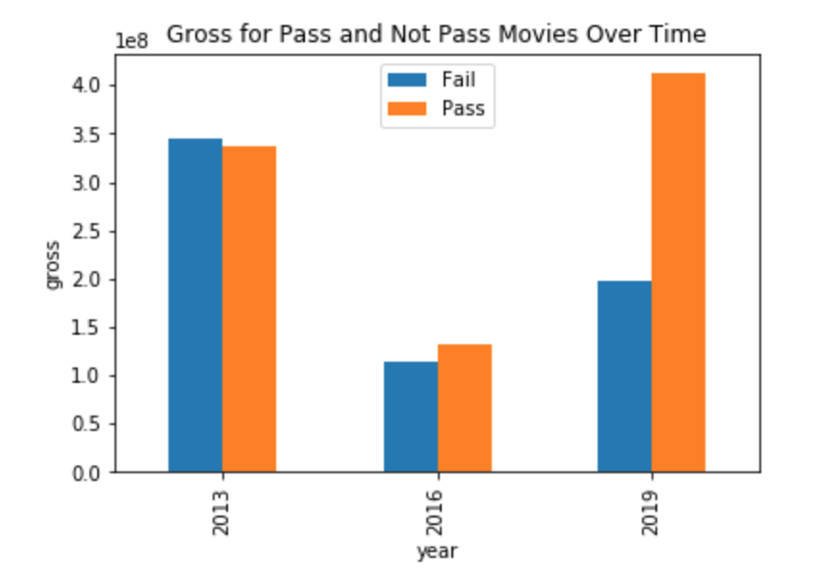
AVERAGE GROSS EARNINGS
After 2013, the data shows a higher increase in gross earnings for movies that pass the test versus movies that fail the test. In 2013, the average gross earnings for movies that passed the test fell short of those that failed by about 8 million dollars. In 2016, the average gross earnings for movies that passed the test surpassed the earnings of those that failed by 10 million dollars. In 2019, gross earnings for movies that passed surpassed movies that failed by 200 million dollars. This may indicate that audiences are now more willing to pay more for movies that pass the test.

Slide 7
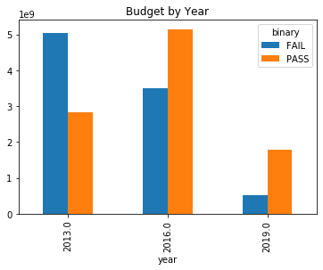
AVERAGE BUDGET
In 2013, as the average budget for movies that passed the test was 5 million dollars lower than those that failed the test. But based on the data from 2016 and 2019, we see a shift in this behavior, as the average budget for films that pass the test surpass those that failed by 5 million dollars, indicating that Hollywood is starting to put more money toward films with equal representation in the years passing films.

Slide 8
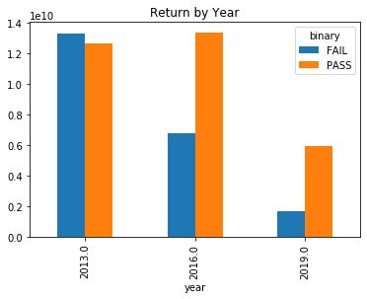
AVERAGE RETURN VALUE
In Hickey’s article, they challenge the assumption that movies featuring more women see a lower return on investment. We looked at the average return value for movies in 2013, 2016 and 2019. In 2013, we see a lower return for movies that pass the test than those that fail. But in both 2016 and 2019 the return on investment for movies that fail surpasses the return for movies that fail by about 5 million dollars. (meaning people invest more money to pass the film)

Slide 9
THE MARVEL FRANCHISE

Slide 10
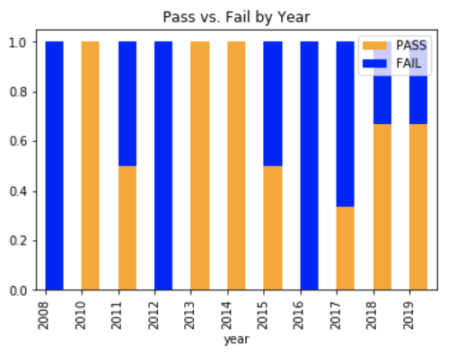
Marvel’s Pass/No Pass Over Time
Overall, Marvel has a pass rate of 51%.
After the #MeToo Movement, the pass rate is 55%.

Slide 11
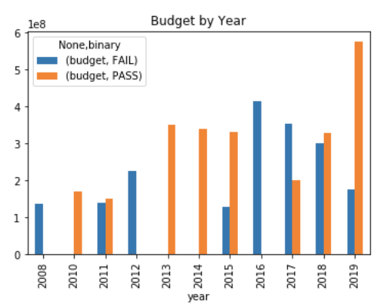
Budget
Average budget for movies that pass is $13 million higher than those that failed.

Slide 12
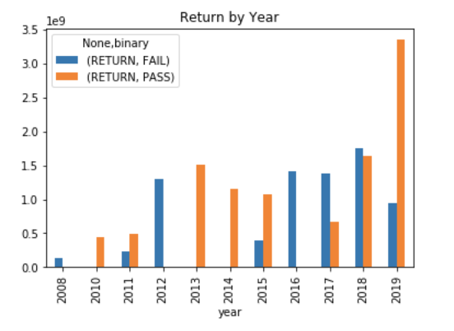
Return
On average, return values for movies that pass are higher than those that failed.
The average return value for Marvel movies that pass is about 861 million dollars, while the average for those that fail falls short of those that pass, with an average return of about 753 million.

Slide 13
Data Modeling

Slide 14
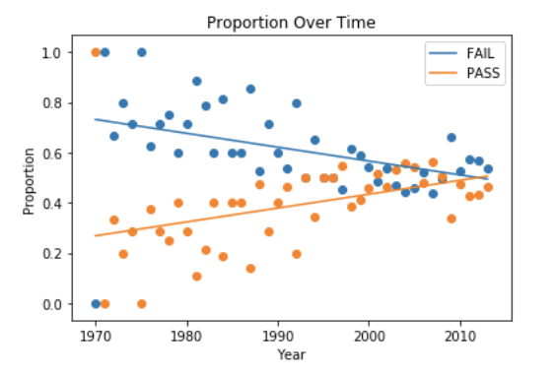
Data Analysis: Proportions
We wanted to compare the trend of proportions of moves that pass versus movies that failed over time. We ran a linear regression for pass rate vs. year and fail rate vs. year. We found an increasing trend over time for proportion of passing films, and a negative trend for proportion of films that fail.

Slide 15
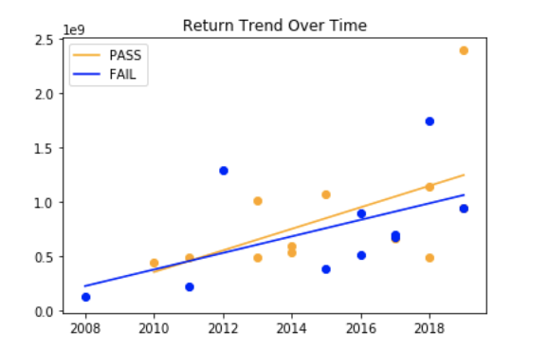
Return Trend Over Time
When comparing trends for passing return value versus fail return values for Marvel Films, we see a greater trend for pass movies versus fail.

Slide 16
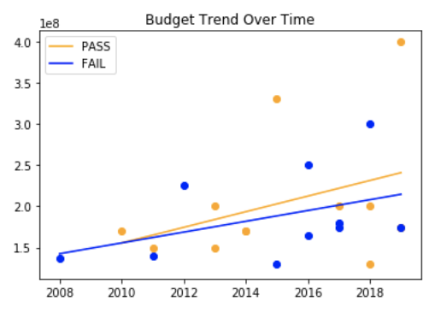
Budget Trend Over Time
When comparing trends for passing return value versus fail return values for Marvel films, we also see a greater trend for pass movies versus fail.

Slide 17
CONCLUSION
The proportion of movies that pass the bechdel test now dominates those that don’t.
Budget, return, and gross earnings for movies that passed have trumped movies that fail after 2013.
We can conclude that there has been an increase in representation of women in film after #MeToo.

